Slide 1
Date: 11 November 2025

Slide 2
Weekly Presentation : Rotor Bearing System
Week number: 07
Date: 11 /11/2025
Supervisor: Prof. Peter Quell
Group members: Divyesh Mistry, Venkata Sreekanth .K , Sreehari Padachery, Jill Sadariya
Presenter : Divyesh Mistry

Slide 3
Agenda
Task of the week.
CAD Model of Spherical roller Bearing.
Bolted Flange Calculation.
Hydraulic Torqure wrench for M39 bolts.
Torque calculation
Bibliography.

Slide 4
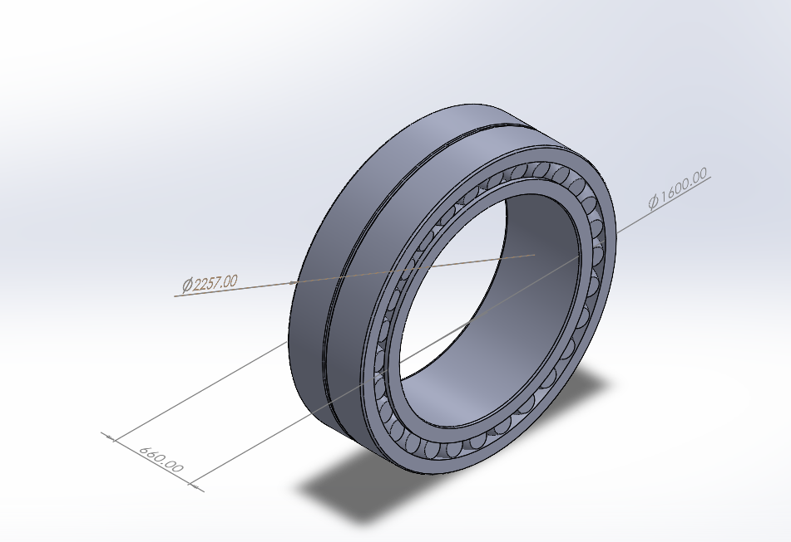
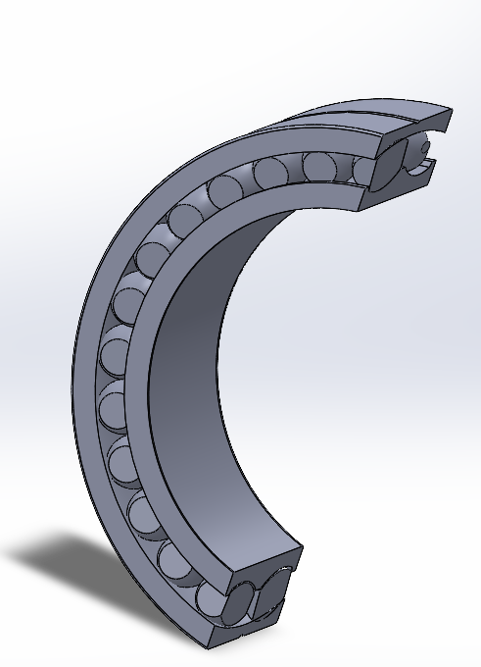
240/1600 CAF/W33 Spherical roller bearing CAD Scaled Model

Slide 5
Bearing Dimensions
Parameter | Symbol | Scaled × 1.4286 (1600 bore)
Bore diameter | d | 1600 mm
Outer diameter | D | 2257 mm
Total width | B | 660 mm
Rollers per row | n | 28
Roller diameter | Dᵣ | 142.86 mm
Roller length | Lᵣ | 266 mm
W33 groove width |  | 17 mm
W33 groove depth |  | 7 mm
Materials |  | Bearing steel / brass (CA)
The scaled bearing size closely matches the specification mentioned in the SKF email communication regarding the outer diameter and width.

Slide 6
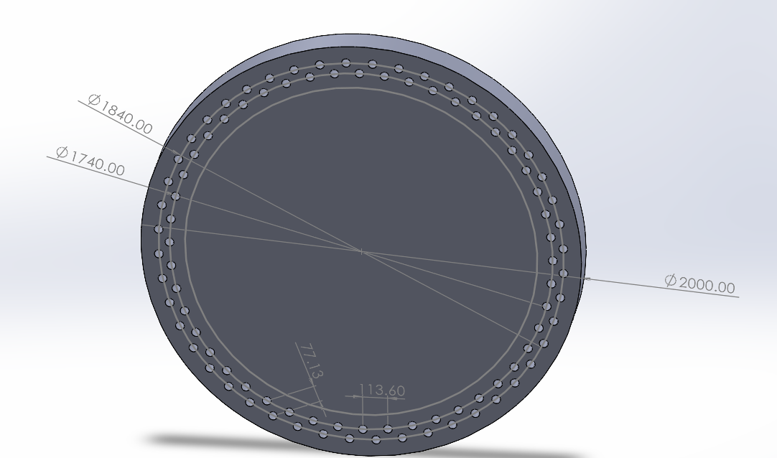
Bolted Flange Calculation
Description | Symbol | Value | Unit
Outer screw circle diameter | dt1 | 1840 | mm
Inner screw circle diameter | dt2 | 1740 | mm
No. of screws per bolt circle diameter | N_{total} = N_{ICB} + N_{OCB} | 96
Total tensile force on flange | F_{a,F,ges} | 633.7 | kN
Lateral force on flange | F_{q,F,ges} | 1810.5 | kN
Torsional moment on flange | M_{t} | 2747.0 | kN.m
Bending moment on flange | M_{B} | 21573.8 | kN.m
*F &M are scaled up from Shakti
Source: Optimus Shakti

Slide 7
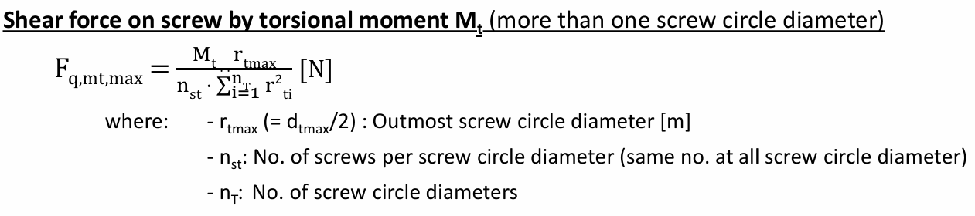
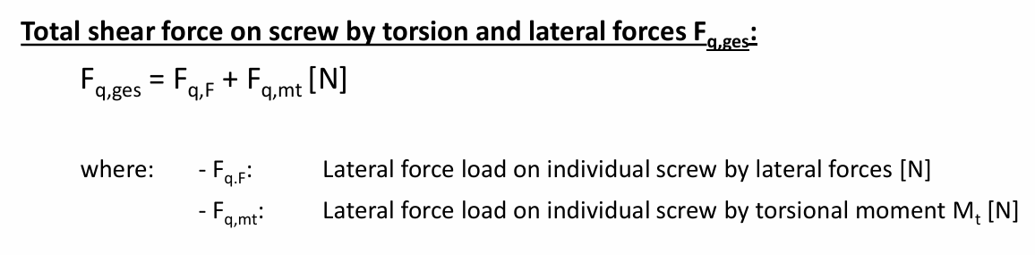
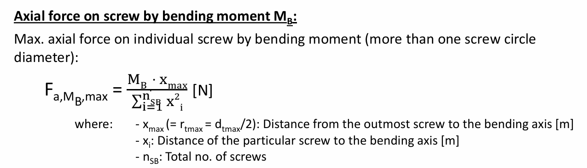



Max Axial Force from Bending Moment (Multi-Circle)
Axial Force from Thrust/Tensile Load
Ferf = Fa,ges + Fkl
Requird total axial force of the screw Ferf

Slide 8
Parameter | Symbol | Unit | Optimus Shakti | Case 2 | Case 3
Screw Circle Radius (Max) | rtmax​ | m | 1.17 | 0.92 | 0.92
Total Number of Screws | Ns​ | - | 116 | 120 | 96
∑xi2​ (Bolt Moment of Inertia) | ∑xi2​ | m2 | 104.97 | 96.38 | 76.96
Max Torsional Moment | Mt​ | kN⋅m | 3183.1 | 2747 | 2747
Max Bending Moment | MB​ | kN⋅m | 25000 | 21573.8 | 21573.8
Axial Force from Bending Moment | Fa,MB,max​ | kN | 64.093 | 205.94 | 257.904
Total Axial Force | Fa,ges​ | kN | 70.127 | 211.221 | 264.505
Total Shear Force | Fq,ges​ | kN | 30.013 | 41.31 | 51.698
Required Total Axial Force (Ferf​) | Ferf​ | kN | 145.16 | 314.496 | 393.751
Minimum Required Stress Area | As,min​ | mm2 | 171.584 | 371.74 | 465.43
Actual Bolt Area (M39/10.9) | As​ | mm2 | 817 | 817 | 817

Slide 9
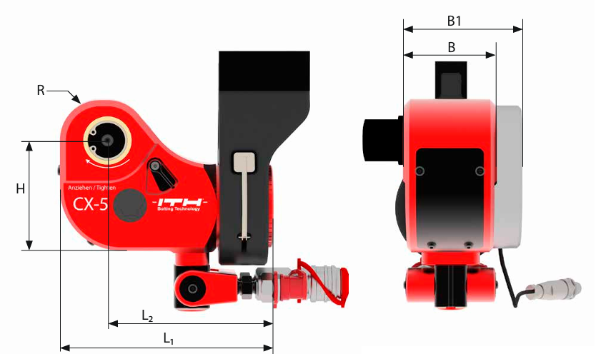
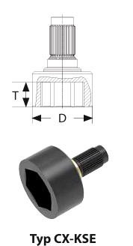
Hydraulic Torqure wrench for M39 bolts
D-93
Diameter of the socket at hexagonal head side of the Bolt
ITH Type- CX 5
Source: ITH

Slide 10
Torque calculation
T = k*F_{fref}*d
F_{preload} =393.751KN
D=39mm=.039m
Well Lubricated (k=0.12)
Unlubricated/Dry (k=0.20)
Well Lubricated (k=0.12)
T = k*F_{fref}*d
T=.12*393751*.039=1844N.m
Unlubricated/Dry (k=0.20)
T = k*F_{fref}*d
T=.20*393751*.039=3071N.m
= Requird total axial force of the screw Ferf

Slide 11
Bibliography – Rotor Bearing System
SKF. (n.d.). 240/1120 CAF/W33 - Spherical roller bearings. Retrieved October 29, 2025, from https://www.skf.com/group/products/rolling-bearings/roller-bearings/spherical-roller-bearings/productid-240%2F1120 CAF%2FW33
Optimus Shakti, Optimus 60E
ITH. (n.d.). ITH Hydraulic Torque Wrenches Catalog. Retrieved November 08, 2025, from www.ITH.de/schraubwerkzeuge/hydraulische-drehmomentschrauber

